Slide 1

Geometry
Unit 8, Lesson 5 Trapezoids Volume 2, pg. 32

Slide 2


Benchmarks
MA.912.GR.1.5
Prove relationships and theorems about trapezoids. Solve mathematical and real-world problems involving postulates, relationships, and theorems of trapezoids.
MA.912.LT.4.10
Judge the validity of arguments and give counterexamples to disprove statements.
volume 2, pg. 32

Slide 3
Integrated Mathematical Thinking and Reasoning Standards
MA.K12.MTR.1.1 Actively participate in effortful learning both individually and collectively.
MA.K12.MTR.2.1 Demonstrate understanding by representing problems in multiple ways.
MA.K12.MTR.4.1 Engage in discussions that reflect on the mathematical thinking of self and others.
MA.K12.MTR.5.1 Use patterns and structure to help understand and connect mathematical concepts.
MA.K12.MTR.7.1 Apply mathematics to real-world contexts.
volume 2, pg. 32

Slide 4

Learning Targets
I can prove relationships and theorems about trapezoids.
I can use relationships and theorems about trapezoids.
volume 2, pg. 32

Slide 5

Warm-Up
volume 2, pg. 33

Slide 6
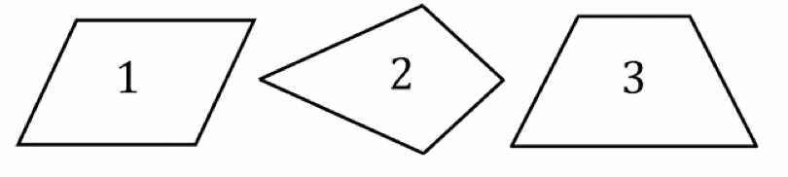
8.5.1 Warm-Up: Trapezoid or Trapezium?
Which quadrilateral is classified as a trapezoid?
volume 2, pg. 33

Slide 7
There is more than one definition of a trapezoid.
There is more than one definition of trapezium.
Inclusive Definition | Exclusive Definition
A quadrilateral with at least one pair of parallel opposite sides. | A quadrilateral with exactly one pair of parallel opposite sides.
American Definition | British Definition
A quadrilateral with no parallel sides. | A quadrilateral with two sides parallel.
volume 2, pg. 33

Slide 8
Use the definitions to classify quadrilaterals 1, 2, and 3. Write the numbers of the quadrilateral in the table.
Inclusive Definition of Trapezoid | Exclusive Definition of Trapezoid
American Definition of Trapezium | British Definition of Trapezium
volume 2, pg. 33

Slide 9

Collaboration
volume 2, pg. 33

Slide 10

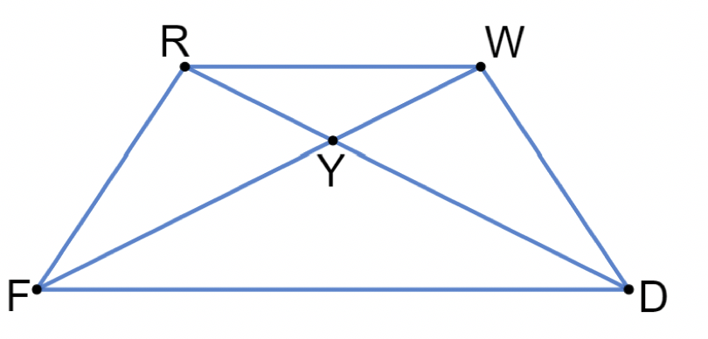
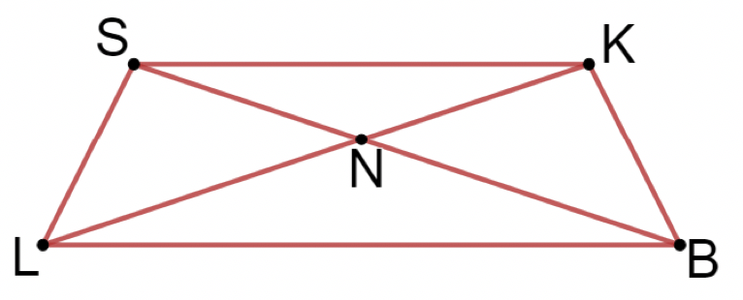
8.5.2 Collaboration: Properties of Isosceles Trapezoids
$RWDF$ and $SKBL$ are both isosceles trapezoids. $\overline{RD}$ and $\overline{WF}$ are the diagonals of $RWDF$ and intersect at point $Y$. $\overline{SB}$ and $\overline{KL}$ are the diagonals of $SKBL$ and intersect at point $N$.
volume 2, pg. 33

Slide 11
Using a ruler and a protractor to measure $RWDF$ and $SKBL$, work with your partner to determine if the following conjectures about isosceles trapezoids are true or false. If false, write a new conjecture based on your measurements.
volume 2, pg. 33

Slide 12
Conjecture | True or False? | If false, write a new conjecture.
All angles of an isosceles trapezoid are congruent
Opposite sides are parallel
Opposites angles are congruent
Opposite sides are congruent
Diagonals bisect each other
Compare your chart to that of another pair. Discuss any differences. Make corrections as necessary.
volume 2, pg. 34

Slide 13
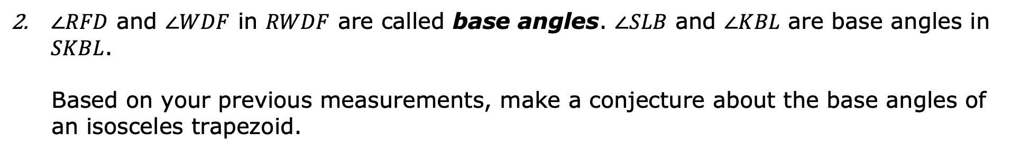
$∠RFD$ and $∠WDF$ in $RWDF$ are called base angles. $∠SLB$ and $∠KBL$ are base angles in $SKBL$.
Based on your previous measurements, make a conjecture about the base angles of an isosceles trapezoid.
volume 2, pg. 34

Slide 14
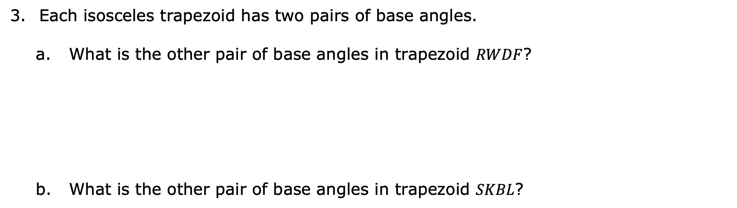
Each isosceles trapezoid has two pairs of base angles.
What is the other pair of base angles in trapezoid $RWDF$?
What is the other pair of base angles in trapezoid $SKBL$?
volume 2, pg. 34

Slide 15

A trapezoid is a quadrilateral with at least one pair of parallel sides. It’s a member of the following shape classes: polygons, quadrilaterals. Its sub-classes include parallelograms, rectangles, rhombuses, and squares.
An isosceles trapezoid is a trapezoid with two pairs of congruent base angles.
4. Make a conjecture about the legs of an isosceles trapezoid.
volume 2, pg. 35

Slide 16

Exploration
volume 2, pg. 35

Slide 17

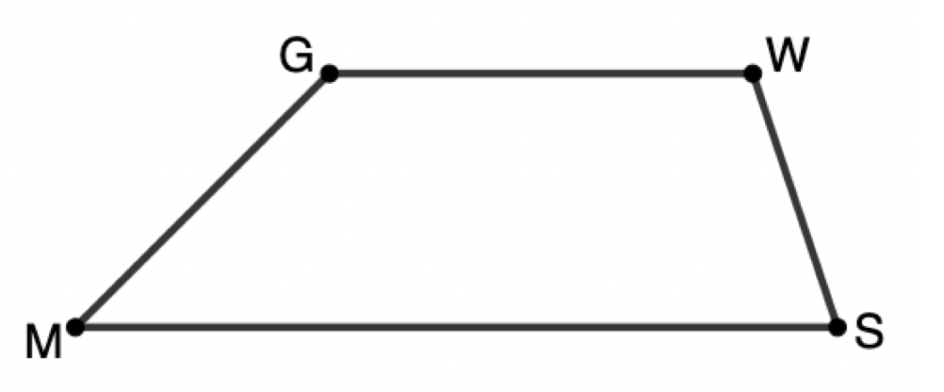
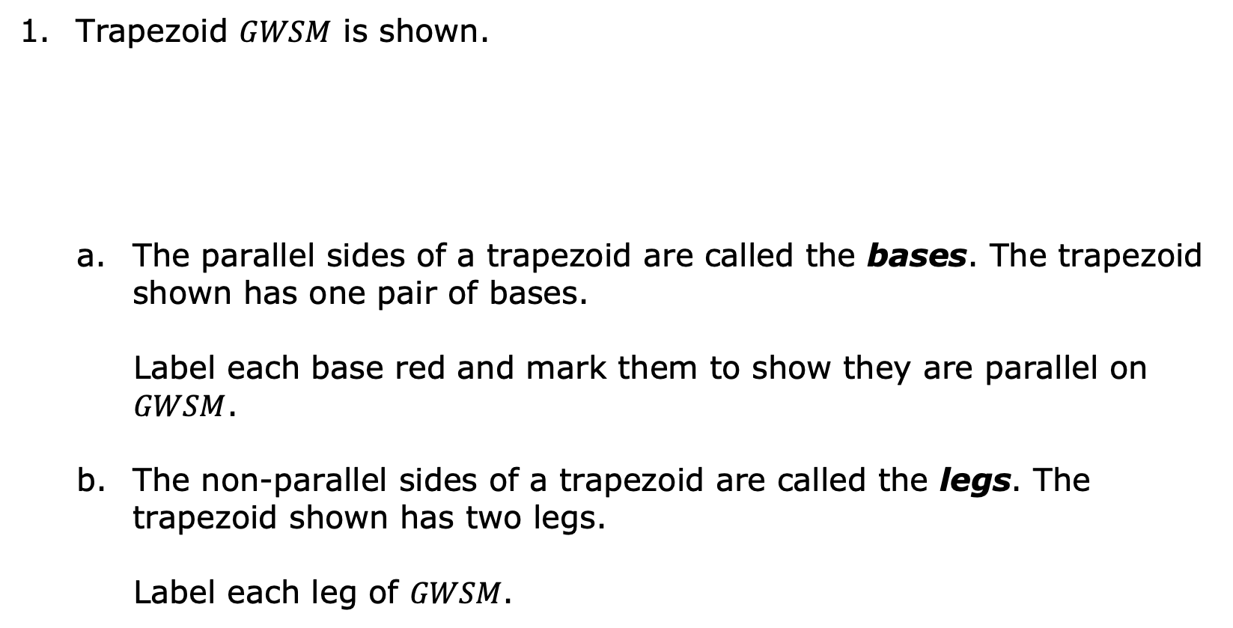
8.5.3 Exploration: Parts of a Trapezoid
Trapezoid $GWSM$ is shown.
The parallel sides of a trapezoid are called the bases. The trapezoid shown has one pair of bases.
Label each base red and mark them to show they are parallel on $GWSM$.
The non-parallel sides of a trapezoid are called the legs. The trapezoid shown has two legs.
Label each leg of $GWSM$.
volume 2, pg. 35

Slide 18

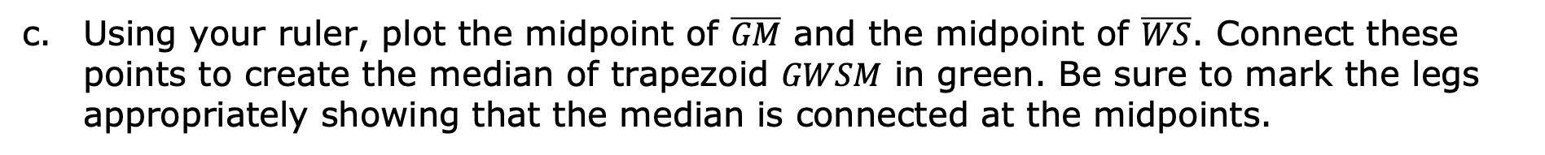
The median of a trapezoid connects the non-parallel sides at their midpoints. The median is sometimes referred to as the midsegment.
Using your ruler, plot the midpoint of $\overline{GM}$ and the midpoint of $\overline{WS}$. Connect these points to create the median of trapezoid $GWSM$ in green. Be sure to mark the legs appropriately showing that the median is connected at the midpoints.
volume 2, pg. 35

Slide 19
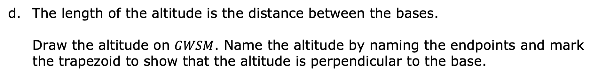
An altitude of a trapezoid is any segment from a point on one of the bases perpendicular to the line containing the other base.
The length of the altitude is the distance between the bases.
Draw the altitude on $GWSM$. Name the altitude by naming the endpoints and mark the trapezoid to show that the altitude is perpendicular to the base.
volume 2, pg. 36

Slide 20
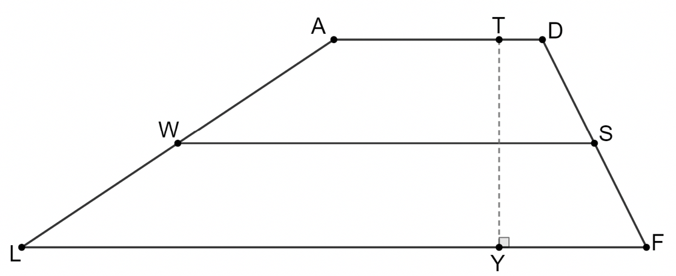
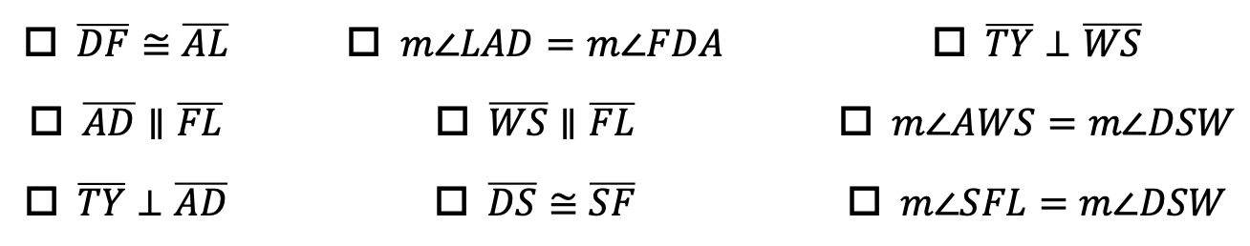
Trapezoid $ADFL$ is shown with midsegment $\overline{WS}$ and altitude $\overline{TY}$.
Select all of the information that is true about $ADFL$.
$\overline{DF}≅\overline{AL}$ |  | $m∠LAD=m∠FDA$ |  | $\overline{TY}⊥\overline{WS}$
$\overline{AD}∥\overline{FL}$ |  | $\overline{WS}∥\overline{FL}$ |  | $m∠AWS=m∠DSW$
$\overline{TY}⊥\overline{AD}$ |  | $\overline{DS}≅\overline{SF}$ |  | $m∠SFL=m∠DSW$
volume 2, pg. 36

Slide 21

Guided Instruction
volume 2, pg. 36

Slide 22
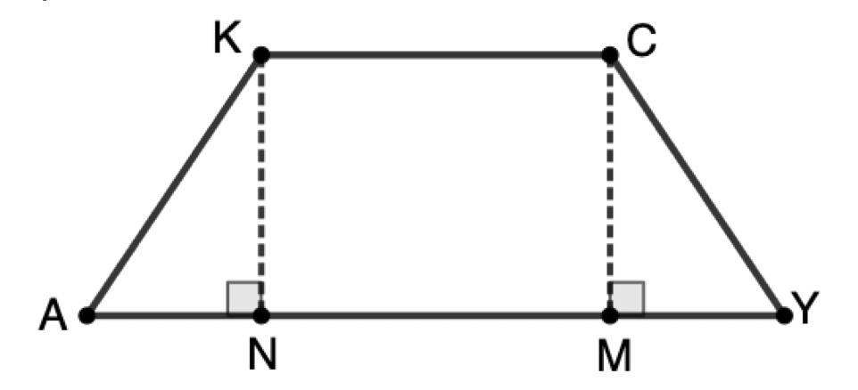

8.5.4 Guided Instruction: Proving Isosceles Trapezoid Properties
Trapezoid $KCYA$ is shown with altitudes $\overline{KN}$ and $\overline{CM}$.
Trace the trapezoid onto a piece of patty paper.
Fold the patty paper so that vertices $K$ and $C$ coincide.
volume 2, pg. 36

Slide 23
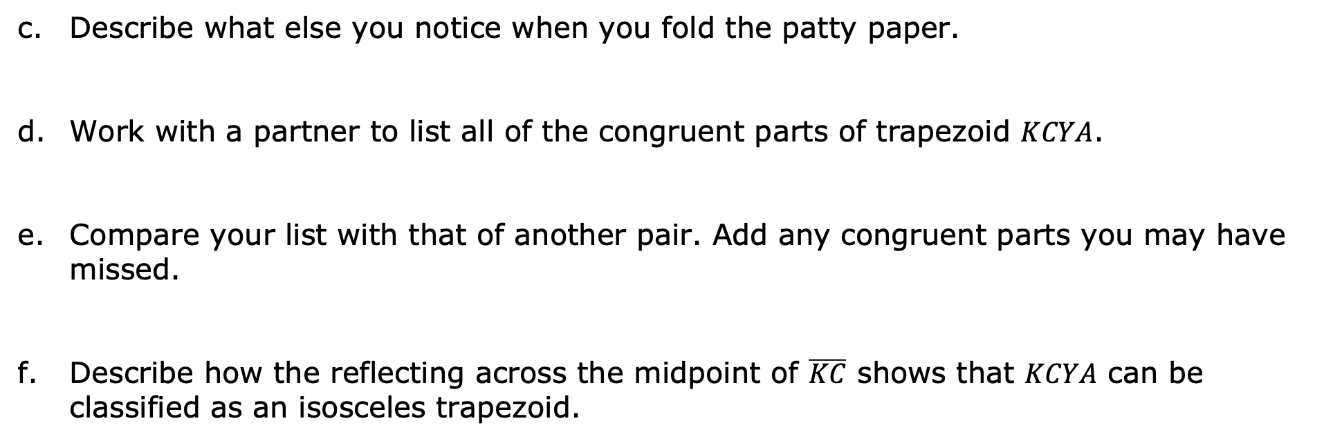
Describe what else you notice when you fold the patty paper.
Work with a partner to list all of the congruent parts of trapezoid $KCYA$.
Compare your list with that of another pair. Add any congruent parts you may have missed.
Describe how the reflecting across the midpoint of $\overline{KC}$ shows that $KCYA$ can be classified as an isosceles trapezoid.
volume 2, pg. 36

Slide 24
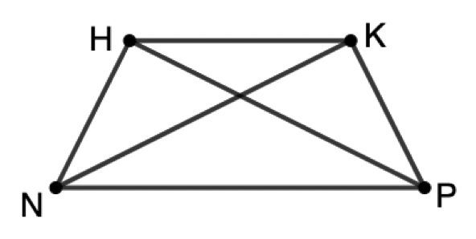
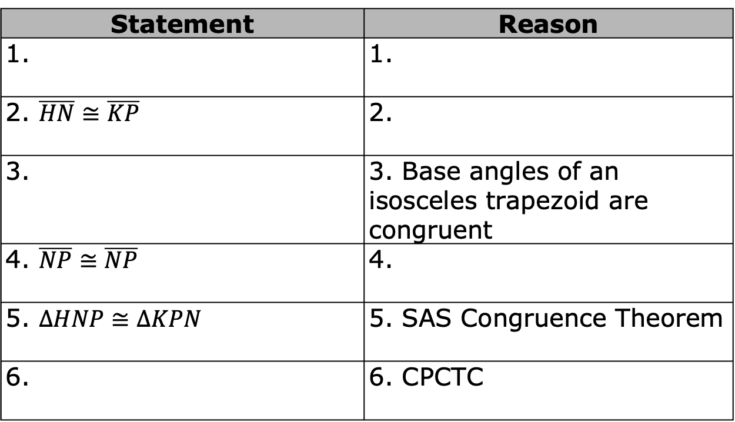
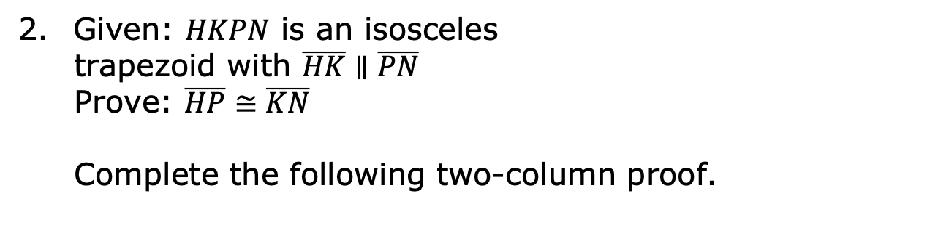
Given: $HKPN$ is an isosceles
trapezoid with $\overline{HK}∥\overline{PN}$
Prove: $\overline{HP}≅\overline{KN}$
Complete the following two-column proof.
Statement | Reason
1. | 1.
2. $\overline{HN}≅\overline{KP}$ | 2.
3. | 3. Base angles of an isosceles trapezoid are congruent
4. $\overline{NP}≅\overline{NP}$ | 4.
5. $∆HNP≅∆KPN$ | 5. SAS Congruence Theorem
6. | 6. CPCTC
volume 2, pg. 37

Slide 25
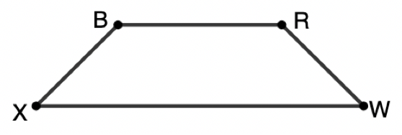
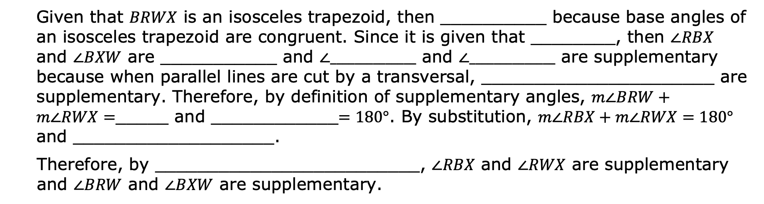
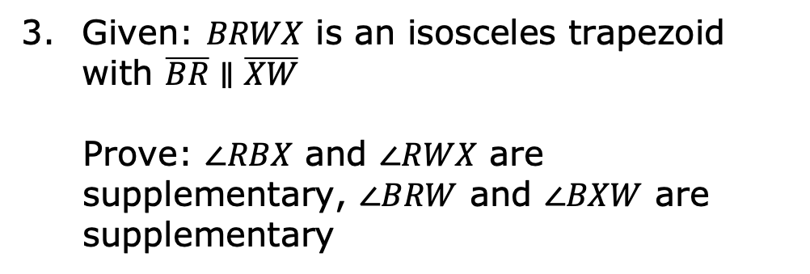
Given: $BRWX$ is an isosceles trapezoid with $\overline{BR}∥\overline{XW}$
Prove: $∠RBX$ and $∠RWX$ are supplementary, $∠BRW$ and $∠BXW$ are supplementary
Given that $BRWX$ is an isosceles trapezoid, then __________ because base angles of an isosceles trapezoid are congruent. Since it is given that ________, then $∠RBX$ and $∠BXW$ are ___________ and $∠______________$ and $∠______________$ are supplementary because when parallel lines are cut by a transversal, ______________________ are supplementary. Therefore, by definition of supplementary angles, $m∠BRW+m∠RWX=$_____ and ____________$=180°$. By substitution, $m∠RBX+m∠RWX=180°$ and ___________________.
Therefore, by _________________________, $∠RBX$ and $∠RWX$ are supplementary and $∠BRW$ and $∠BXW$ are supplementary.
volume 2, pg. 37

Slide 26

Guided Practice
volume 2, pg. 38

Slide 27

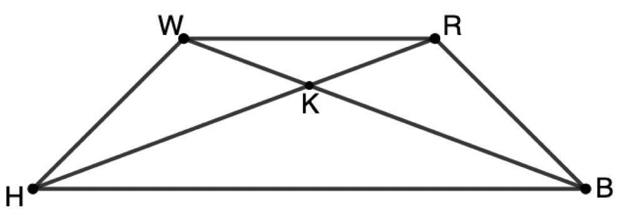

8.5.5 Guided Practice: Isosceles Trapezoids
$WRBH$ is an isosceles trapezoid.
If diagonal $\overline{WB}=18$ and diagonal $\overline{RH}=3x−7$, find the value of $x$.
Diagonals $\overline{WB}$ and $\overline{RH}$ intersect at point $K$. If $m∠RWB=20.6°$, $m∠RHW=24.4°$, and $m∠BKH=138.8°$, what is $m∠WRB$?
volume 2, pg. 38

Slide 28
Isosceles trapezoid $KCYA$ has altitudes $\overline{KN}$ and $\overline{CM}$. If $KC=6, AY=30, and KA=15,$ what is the length of altitude $\overline{CM}$?
volume 2, pg. 38

Slide 29

Wrap-Up
volume 2, pg. 38

Slide 30
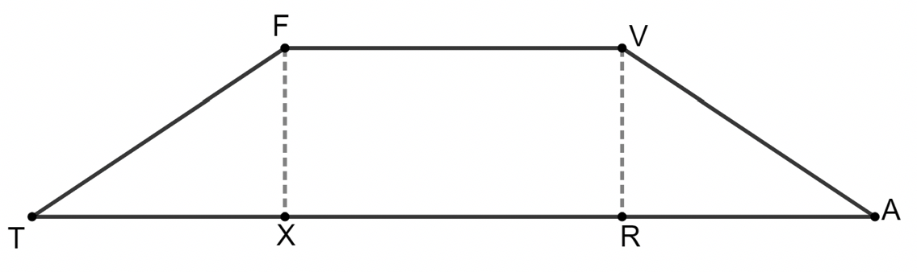

8.5.6 Wrap-Up: Ticket Out the Door
Isosceles trapezoid $FVAT$ is shown with altitudes $\overline{FX}$ and $\overline{VR}$.
If $FT=12$, $TA=36\sqrt{5}$, and $VR=8$, what is the length of $\overline{FV}$?
volume 2, pg. 38

